Slide 1
Data Mining in Health Analytics and A Quick Look at SAS Enterprise Miner Interface
Ram Poudel
Department of Behavioral Pediatrics
June 2nd , 2015

Slide 2
Objectives
Overview Data Mining
Overview the basic principle and best practices in Data Mining
Describe the basic navigation of SAS EM
Give a high level overview of three widely used modeling algorithms
Discuss the application of Data Mining in health care.
Notes:
Mention supervised and unsupervised. In this presentation we mainly discuss on supervised classification where TARGET is present.

Slide 3

Health Analytics and Categories
Descriptive Describing what has happened
Predictive Predicting what will happen
Prescriptive Determining what to do about
Notes:
Not only health analytics. It is general for all types of analytics but here we are discussing health analytics. not all analyses of large quantities of data constitute data
mining. We generally categorize analytics as above. To the middle category “Predictive Analytics” that Data Mining applies.

Slide 4
Data Mining
Definition
Data Mining is the analysis of large data sets to discover patterns and use those patterns to forecast or predict the likelihood of future events ¹.
Patterns should be
Valid
Novel
Useful
Understandable
¹ Crockett, et. al, 2014
Notes:
Data mining involves uncovering patterns from vast data stores and using that information to build predictive models. Many industries successfully use data mining. It helps the retail
industry model customer response. It helps banks predict customer profitability. It serves similar use cases in telecom, manufacturing, the automotive industry, higher education, life sciences, and more.
Data mining holds great potential for the healthcare industry. But due to the complexity of healthcare and a slower rate of technology adoption, our industry lags behind these others in implementing
effective data mining strategies. In fact, data mining in healthcare today remains, for the most part, an academic exercise with only a few pragmatic success stories.
Academicians are using data-mining approaches like decision trees, clusters, neural networks, and time series to publish research.
Healthcare, however, has always been slow to incorporate the latest research into everyday practice.
Valid: The patterns hold in general. Novel: Not known the pattern beforehand. Useful: Can devised actions from the patterns. Understandable: Should be interpreted and comprehended the patterns.

Slide 5
Modeling Essentials
Predict New Cases
Select useful inputs
Optimize complexity

Slide 6
Types of Prediction
Decisions
Rankings
Estimates
Notes:
Decision – readimission (yes/no). Fraud (Yes/no)

Slide 7
Honest Assessment: A Basic Principle of Data Mining
Splitting the data:
Training Data Set – this is a must do
Validation Data Set – this is a must do
Testing Data Set – this is optional

Slide 8
Best Practices in Data Mining
Handling Missing Values
Empty vs. Missing
1. Decision Trees have built in methods for handling missing values.
2. Equation “type” algorithms, e.g. Logistic Regression and Neural Networks, do Complete Case Analysis
Notes:
In regression and neural network if missing values are not imputed samples will be very small since they do Complete Case Analysis. With missing values it is not advisable to score the new dataset (even a decision tree can handle the missing values).

Slide 9
Best Practices in Data Mining
Transformation of the variables
For Regression, it is a must but better for Decision Tree and Neural Net too.
Variable Selection
Better to select variables especially for Neural Net
Notes:
Since Neural Net has a complex hidden algorithms it is better to have few important variables. It can be do by running Decision tree or regression before Neural Net.

Slide 10


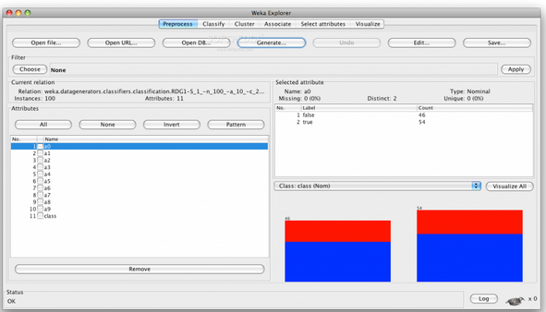
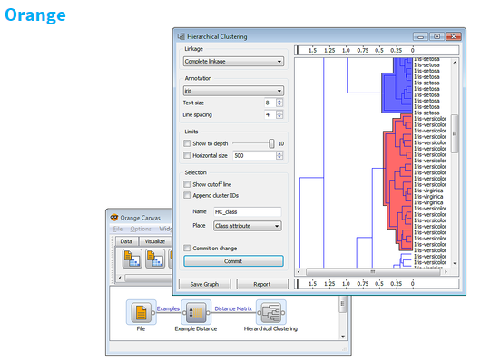
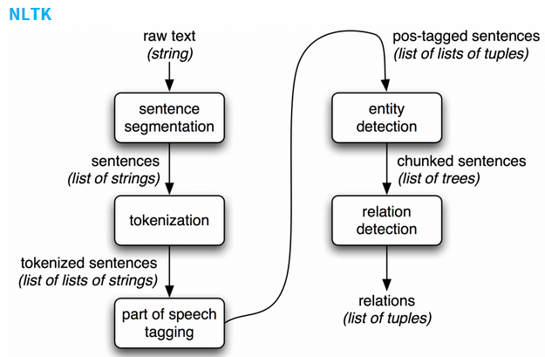
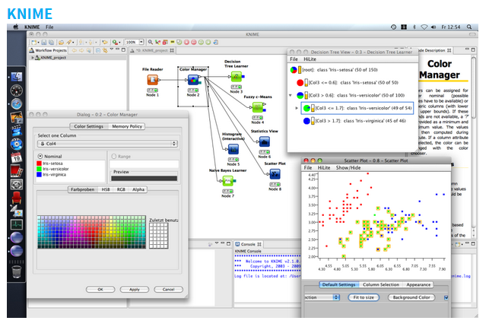
Open Tools for Data Mining
WEKA

Slide 11
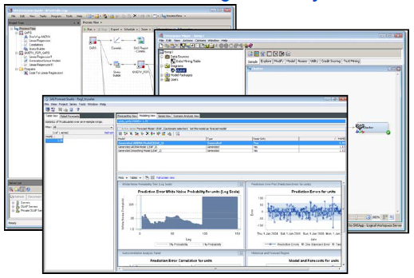
Tools for Data Mining from SAS System
SAS EG
SAS EM
SAS Forecast Studio
JMP

Slide 12
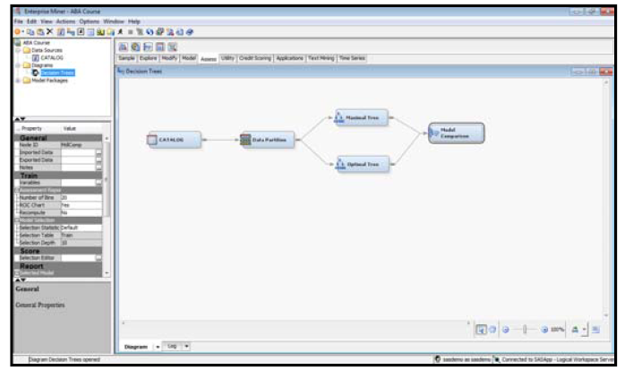
Introduction to SAS Enterprise Miner
SAS EM streamlines the Data Mining process to create highly accurate predictive and descriptive models based on the vast amount of data gathered from across an entity.

Slide 13
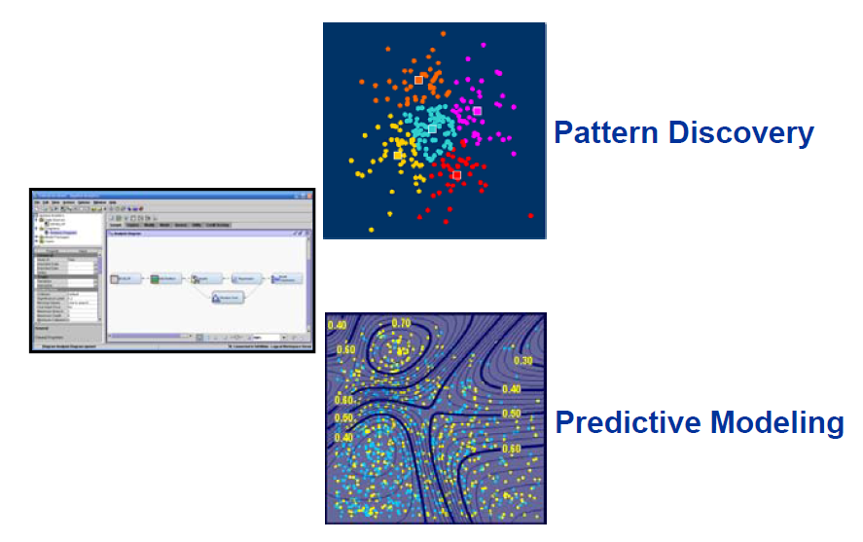
SAS EM Analytic Strengths

Slide 14
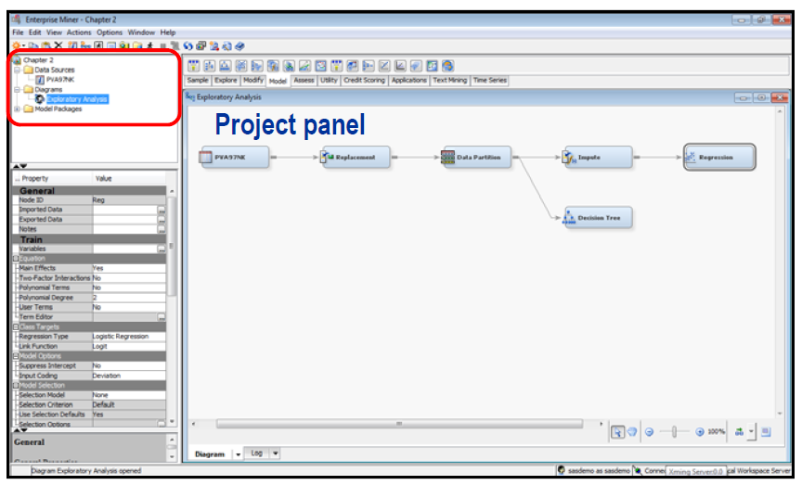
SAS EM – Interface Tour

Slide 15
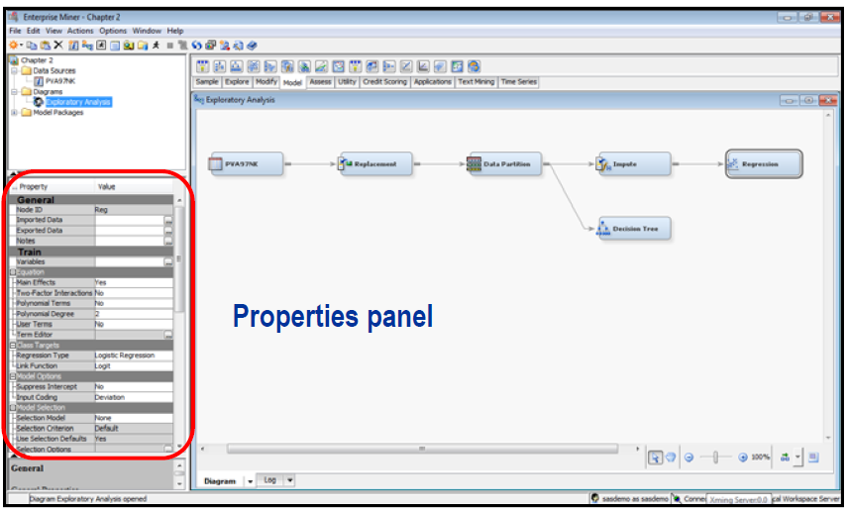
SAS EM – Interface Tour

Slide 16
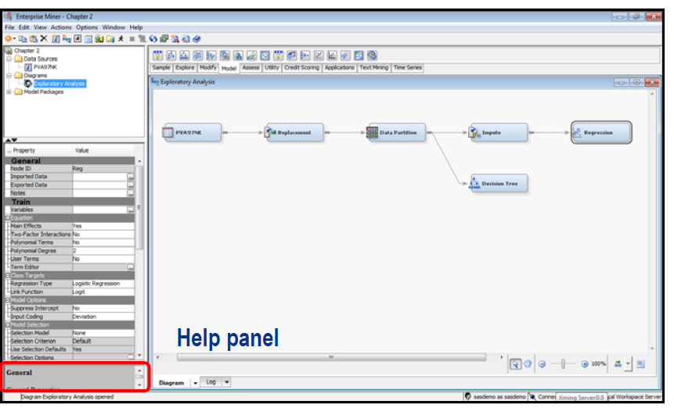
SAS EM – Interface Tour

Slide 17
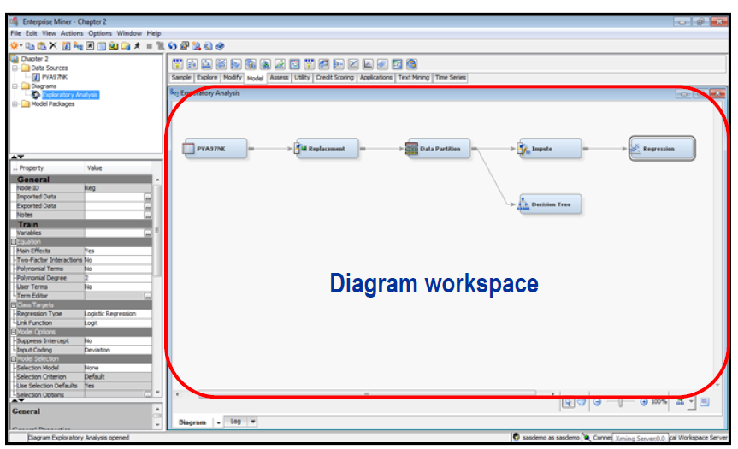
SAS EM – Interface Tour

Slide 18
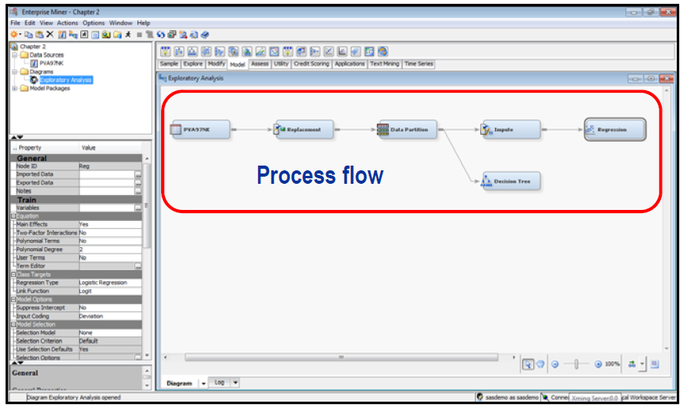
SAS EM – Interface Tour

Slide 19
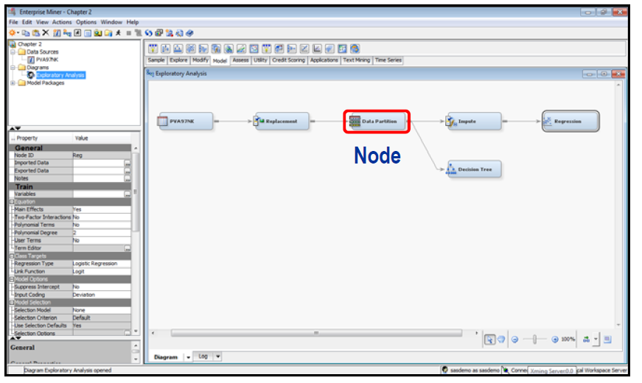
SAS EM – Interface Tour

Slide 20
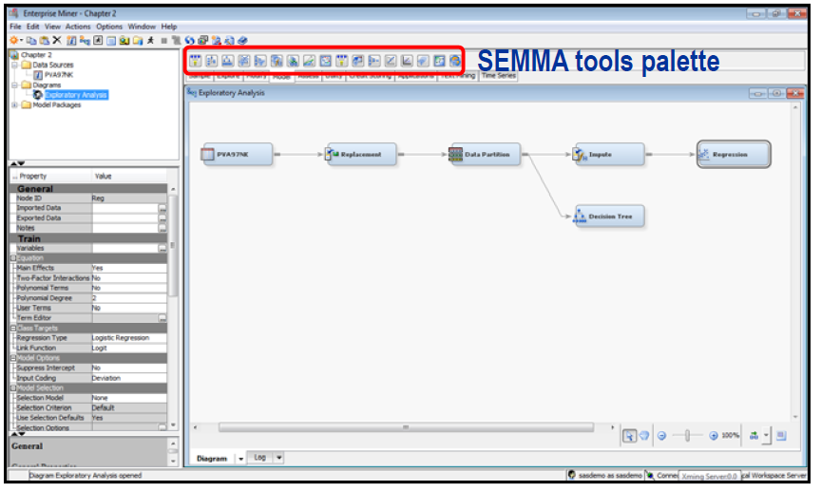
SAS EM – Interface Tour

Slide 21
Three Mostly Used Modeling Algorithms
1.Regression
Models with Binary Target
Models with an Ordinary Target
Models with a Nominal (Unordered) Target
Models with Continuous Target

Slide 22
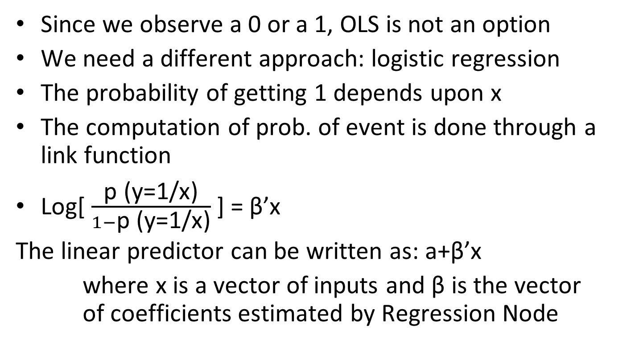
Models with Binary Target: Logistic Regression
Since we observe a 0 or a 1, OLS is not an option
We need a different approach: logistic regression
The probability of getting 1 depends upon x
The computation of prob. of event is done through a link function
Log[ $\frac{\text{p}\text{ (}\text{y}\text{=1/}\text{x}\text{)}}{1−\text{p}\text{ (}\text{y}\text{=1/}\text{x}\text{)}}$] = β’x
The linear predictor can be written as: a+β’x
where x is a vector of inputs and β is the vector of coefficients estimated by Regression Node

Slide 23
Deciding the Best Level of Complexity
The model with the fewest terms (parsimonious)
The model with largest (smallest) value of our criteria index (adj. r-square, misclassification rate, AIC, BIC, SBC etc.)
Using the validation set to compute the criteria (fit index) for each model and then choose the “best”

Slide 24
Fit Indices (Statistics)
Default
Akaike’s Information Criterion
Average Squared Error
Mean Squared Error
ROC
Captured Response
Gain
Gini Coefficient
Kolmogorov-Smirnov Statistic
Lift
Misclassification Rate
Average Profit/Loss
Percent Response
Cumulative Captured Response
Cumulative Lift
Cumulative Percent Response

Slide 25
Three Mostly Used Modeling Algorithms
2.Decision Tree
Very simple to understand
Easy to use
Can explain to the supervisor

Slide 26
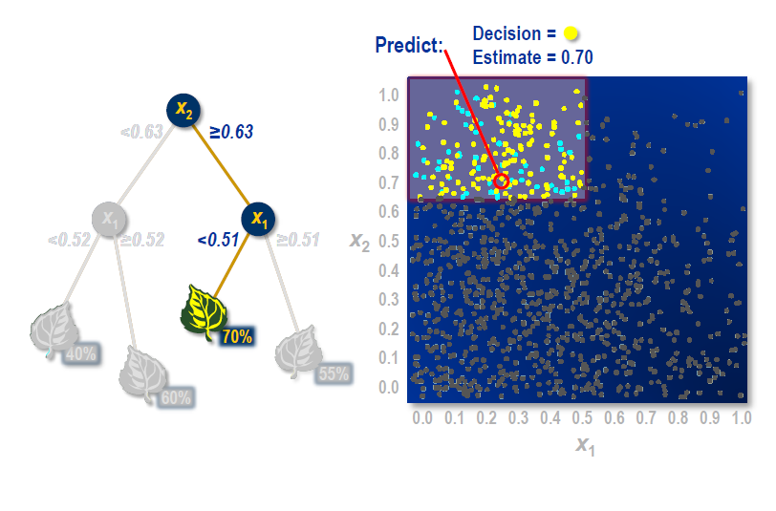
Decision Tree Prediction Rules
Chi-Square (Log-worth= -log ( p-value)
GINI p₁² + p₂²
Entropy (-1p₁log₂(p₁)+p₂log₂(p₂))

Slide 27
Three Mostly Used Modeling Algorithms
2.Neural Net
Very complex mathematical equations
Interpretations of the meaning of the input variables are not possible with final model
Very flexible in accommodating non-linear associations between inputs and target

Slide 28
Two Cultures
Machine Learning
Biological Simulation
Features
Inputs
Outputs
Synaptic Weights
Bias
Neurons
Learning
Statistics
Predictive Modeling
Variables
Independent Variables
Dependent Variables
Parameter Values
Intercept
Terms
Fitting Models

Slide 29
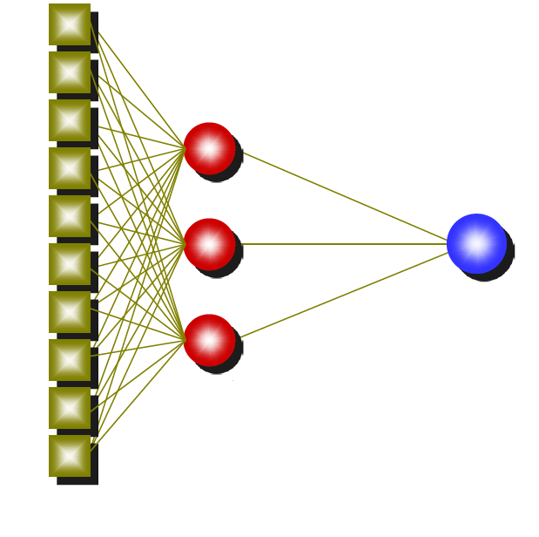
Multilayer Perceptron (MLP)
Hidden Layer
Input Layer
Output Layer
Hidden Unit
(Neuron)
Developed with the intention to resemble how the human brain works

Slide 30

Overall Comparison
Regression
Validation Set
Validation Fit
Decision Tree
Validation Set
Validation Fit
Neural Net
Validation Set
Validation Fit
Find the model of optimal complexity for each family, and then choose overall champion, based on validation performance

Slide 31
Demo of Software
Goal:
To predict as many current 4G customers as possible correctly analyzing existing customer usage and demographic data so that cellular company can identify which customers are likely to switch to 4G network.
Data Description:
A sample dataset of 20,000 3G network customers and 4,000 4G network customers has 249 input variables, one ID variable, and one categorical target variable “Customer_Type” (3G/4G). A 4G customer is defined as a customer who has a 4G Subscriber Identity Module (SIM) card and is currently using a 4G network compatible cellular phone. Three-quarters of the dataset (15,000 3G and 3,000 4G) have the target field and used for model training and validation. The remaining portion of dataset is the scoring data with 5,000 3G and 1,000 4G customers without target variable to test the predictive capability of a developed model.

Slide 32
Some Applications of DM in Health Analytics
Treatment Effectiveness
Customer Relationship Management
Health care management
Tracking Fee-for-service and Value-based Payer Contracts
Monitoring and Predicting Fee-for-service Volumes
Improving Primary Care Reporting
Predicting Patient Population Risk
Preventing Hospital Readmissions
Preventing fraud and abuse

Slide 33
Limitations of Data Mining in Health Analytics
Accessibility of data
Missing, corrupted, inconsistent, or non-standardized data
Fear of data dredging or fishing
Requiring domain knowledge statistical and research expertise, and IT and data mining knowledge and skills

Slide 34
Future Directions
Standardization of clinical vocabulary and the sharing of data across organizations to enhance the benefits of healthcare data mining applications.
Should not be limited to just quantitative data but the use of text mining to be explored.
There is some progress of using digital diagnostic images in data mining applications.
Notes:
relevant concept: complement event

Slide 35
References
Milley, A. (2000). Healthcare and data mining. Health Management Technology, 21(8), 44-47.
Biafore, S. (1999). Predictive solutions bring more power to decision makers. Health Management Technology, 20(10), 12-14.
Silver, M. Sakata, T. Su, H.C. Herman, C. Dolins, S.B. & O’Shea, M.J. (2001). Case study: how to apply data mining techniques in a healthcare data
Benko, A. & Wilson, B. (2003). Online decision support gives plans an edge. Managed Healthcare Executive, 13(5), 20.
Kolar, H.R. (2001). Caring for healthcare. Health Management Technology, 22(4), 46-47.
Relles, D. Ridgeway, G. & Carter, G. (2002). Data mining and the implementation of a prospective payment system for inpatient rehabilitation.
Health Services & Outcomes Research Methodology, 3(3-4), 247-266.
Trybula, W.J. (1997). Data mining and knowledge discovery. Annual Review of Information Science and Technology, 32, 197-229.
Chung, H.M. & Gray, P. (1999). Data mining. Journal of Management Information Systems, 16(1), 11-16.
Kreuze, D. (2001). Debugging hospitals. Technology Review, 104(2), 32.
Veletsos, A. (2003). Getting to the bottom of hospital finances. Health Management Technology, 24(8), 30-31.
Dakins, D.R. (2001). Center takes data tracking to heart. Health Data Management, 9(1), 32-36.
Johnson, D.E.L. (2001). Web-based data analysis tools help providers, MCOs contain costs. Health Care Strategic Management, 19(4), 16-19.
Piazza, P. (2002). Health alerts to fight bioterror. Security Management, 46(5), 40.
Brewin, B. (2003). New health data net may help in fight against SARS. Computerworld, 37(17), 1, 59.
Hallick, J.N. (2001), Analytics and the data warehouse. Health Management Technology, 22(6), 24-25.
Rafalski, E. (2002). Using data mining and data repository methods to identify marketing opportunities in healthcare. Journal of Consumer Marketing, 19(7), 607-613.

Slide 36
Q & A
Thank you

